Slide 1
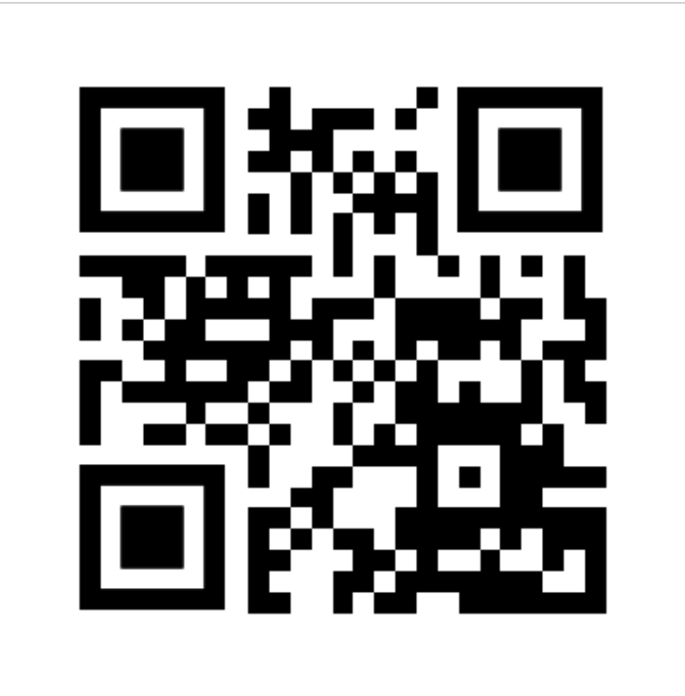
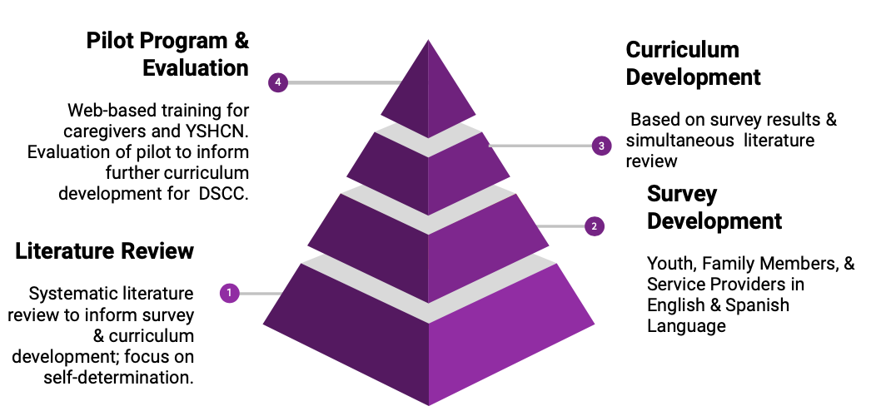
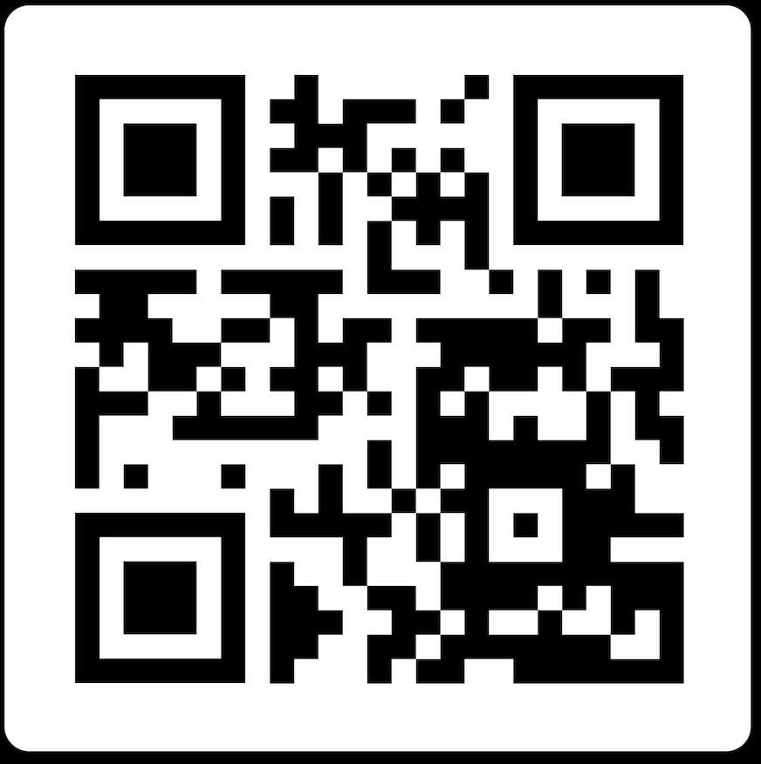
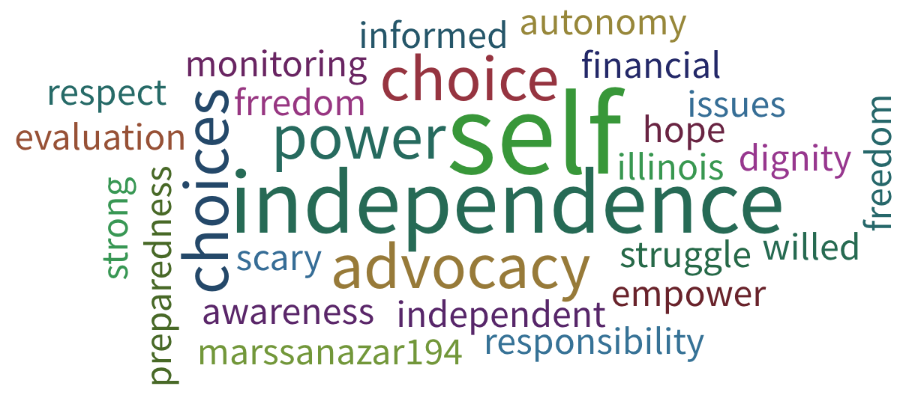
Self-Determination in the Transition to Adulthood
Victoria Eickelberg, Emma Fox, Amy Harshbarger, Marissa Nazareno, Shijin Ye
University of Illinois at Chicago (UIC), Division of Specialized Care for Children (UIC-DSCC)
Background
Survey Development, Execution, and Results
Conclusion
What is the problem with transition?
Poor employment and independent living outcomes.¹
Lack of services: 90.2% of children and youth with special healthcare needs (CYSHCN) in IL do not receive adequate transition services.²
Services to prepare for post-secondary transition tend to start late.³
Why is self-determination important?
Academic success^{3,4,5}
Positive adult outcomes & better quality of life ^{6,7,8}
Actively contribute to their transition planning⁹
Envision person-centered life and career goals⁹
Identified audience for curriculum: family, youth, and providers
Created a survey for each audience via Qualtrics (including Spanish versions)
Sought feedback from UIC-DSCC family advisory council
Implemented revisions and adjusted reading level
Distributed to stakeholders across the state, including care providers, community organizations, families, and self-advocates
Gathered feedback to help inform our training session (Respondents: 23 family members, 6 youth, 73 providers)
Quotes from Survey Results:
From a youth...“I think that the part of transition to adulthood that scares me the most if just being financially responsible”
From a provider…”All of it concerns me. The few participants I have that are capable of working or need programs - I felt lost in providing them with opportunities that fit their needs.”
From a family member…”Our daughter is fairly sheltered. I worry about her surviving emotionally in the real world. “
Pilot Training Participant Feedback:
Pre Survey response- “ I want to learn best practices,strategies and implementation to build/increase transition program at school level.”
Post Survey response- “ I am just beginning my education in youth transition and this was perfect” & “Resources I can use right now”!
Recommendations for Future trainings:
Longer training session ( >3 hours) to allow greater time for activities and discussion
More outreach to youth for a greater youth audience/input
More training sessions at different times of the day or offering child care to help families attend
Next Steps for Future Trainees:
Design tools to measure behavior changes
Add individualized breakout sessions for youth, families, and providers
Invite youth with disabilities to share their experience with self-determination
Aims
Develop a train-the-trainer curriculum on supporting CYSHCN in building self-determination skills
Pilot the curriculum with CYSHCN, family members, and care/service providers
Help families of CYSHCN prepare for transition
Pilot Training Session Components
Two pilot training sessions took place, one in Chicago and another in Bloomington-Normal, Illinois. The two training sessions were conducted via a web-based service to allow for interaction between the sites. The training session took place during the course of 3 hours on a weekday afternoon.
Role | # of Participants
Youth | 3
Family | 10
Providers | 16
Transition: process of making and acting on plans for life after high school; it is never too early to start!
Self-Determination: understanding your strengths and weaknesses + believing you are capable and effective → goal directed behavior with as much or as little support as you would like:
Elements of Self-Determination:
Self-Awareness
Self-Advocacy
Decision-Making
Case Discussions: interdisciplinary groups used strengths-based approach to propose goals and next steps for youth and their support networks
Resources: distributed list of local, statewide, and national resources (see QR code above)
References
Process
What are some words that come to mind when you think of self-determination?
Acknowledgements
This work was supported by the Illinois LEND Program [Grant Number: T73MC11047; U.S. Department of Health and Human Services—Health Resources and Services Administration (HRSA)].
Notes:
Denney, S. C., & Daviso, A. W. (2012). Self-determination: a critical component of education. American Secondary Education, 40(2), 42-51
Child and Adolescent Health Measurement Initiative. 2017 National Survey of Children’s Health (NSCH) data query. Data Resource Center for Child and Adolescent Health supported by Cooperative Agreement U59MC27866 from the U.S. Department of Health and Human Services, Health Resources and Services Administration’s Maternal and Child Health Bureau (HRSA MCHB). Retrieved 03/07/2019 from www.childhealthdata.org. CAHMI: www.cahmi.org
Cobb, B., Lehmann, J., Newman-Gonchar, R., Alwell, M. (2009). Self-determination for students with disabilities: A narrative metasynthesis. Career Development for Exceptional Individuals, 32 (2),108–114.
Carter, E. W., & Lunsford, L. B. (2005). Meaningful work: improving employment outcomes for transition age youth with emotional and behavioral disorders. Preventing School Failure, 49(2), 63-69.
Ju, S., Zeng, W., & Landmark, L. J. (2017). Self-Determination and Academic Success of Students With Disabilities in Postsecondary Education: A Review. Journal of Disability Policy Studies, 28(3), 180–189.
Wehmeyer, M. L., & Palmer, S. B. (2003). Adult outcomes for students with cognitive disabilities three years after high school: The impact of self-determination. Education and Training in Developmental Disabilities, 38(2), 131-144.
Wilgosh, L., Sobsey, D., & Cey, R. (2008). Life management of postsecondary students with disabilities. Developmental Disabilities Bulletin, 36(1&2), 199-224.
Nota, L., Ferrari, L., Soresi, S., & Wehmeyer, M. (2007). Self-determination, social abilities, and the quality of life of people with intellectual disability. Journal of Intellectual Disability Research, 51(11), 850-865.
Radcliff, R. & Bos, B. (2011) Mentoring Approaches to Create a College Going Culture for At-Risk Secondary Level Students. American Secondary Education, 39(3) 86-107.

